Slide 1

WELCOME TO OUR DEFENSE

Slide 2

INTERNSHIP
THEME: CENTRALIZED APPLICATION FOR THE SURVEY OF TRAINING AND PREPARATION FOR ATTESTATIONS
CASE-STUDY: UNIVERSBINAIRE
Carried out from the 3rd of July to the 30th of September 2023 in view of obtaining a higher Technical Diploma in Software Engineering
Presented By
EPAH FONZOCK MANYI
Supervisors
Academic Supervisor
Mrs. TCHINGA Alice
Lecturer at AICS Cameroon
Professional Supervisor
Mr. GAPIAPSI NGUETO MARTIAL
CEO of UNIVRSBINAIRE

Slide 3

INTRODUCTION
CONTEXT, PROBLEMATICS, AND SOLUTIONS
METHODOLOGY
DEMONSTRATION
CONCLUSION

Slide 4
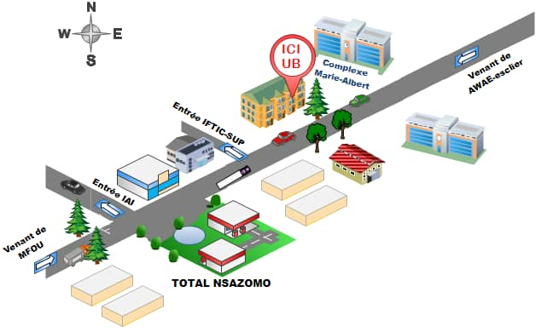
INTRODUCTION
GEOGRAPHICAL LOCATION

Slide 5
MISSIONS
INTRODUCTION
UNIVERSBINAIRE’S main mission is to solve daily problems encountered by different companies related to computer sciences.
They also offer training attestations and or certifications for those who wish to ameliorate their knowledge in computer science

Slide 6


KEY REALIZATIONS
INTR0DUCTION
UNIVERSBINAIRE has realized multiple software applications and many others are still in the making. Here are a few below.
Which is a hospital and health management software
Which is an E-commerce platform

Slide 7
CUSTOMERS AND PARTNERS
INTRODUCTION
Some of UNIVERSBINAIRE’S Customers and Partners include;
MAMECAA SERVICES: Printing
KILO EXPRESS: Sending and receiving packages
SOTOCOG: Civil engineering construction
Just to name a few…

Slide 8

CONTEXT AND PROBLEMATICS

Slide 9
CONTEXT AND PROBLEMATICS
CONTEXT
What we are striving to do at the moment is transform every hardship, labor into something more evident and effective to do. The main problem encountered at the level of the enterprise UNIVBERSBINAIRE SARL is the fact that certification and knowledge testing are done in presence that is, a day is fixed for every trainee taking a test, for the certification process to take place right from having a written test to a graduation ceremony.

Slide 10

CONTEXT AND PROBLEMATICS
B) PROBLEMATICS
What about those who can’t make it in presence? Are they just going to be discarded from taking the test? Well of course not. Therefore, how can an individual who is now someone who has had training take the test and obtain an attestation without necessarily being present?

Slide 11

SOLUTIONS
In that light, we came up with a CENTRALIZED APPLICATION FOR THE SURVEY OF TRAINING AND PREPARATION OF ATTESTATIONS in order to ease taking of knowledge tests for both students and Trainers.

Slide 12
METHODOLOGY

Slide 13
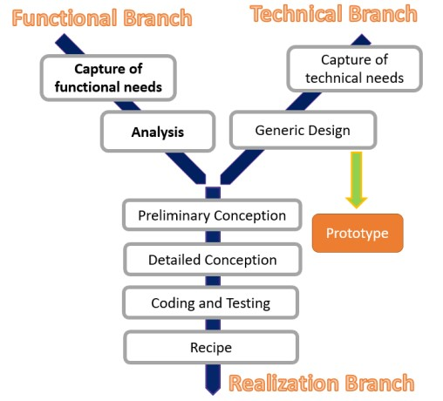

METHODOLOGY

Slide 14
FUNCTIONAL BRANCH
GENERAL USECASE DIAGRAM

Slide 15
FUNCTIONAL BRANCH
ACTIVITY DIAGRAM TAKES QUIZ

Slide 16
REALIZATION BRANCH
CLASS DIAGRAM

Slide 17
SEQUENCE DIAGRAM TAKES EXAM
REALIZATION BRANCH

Slide 18
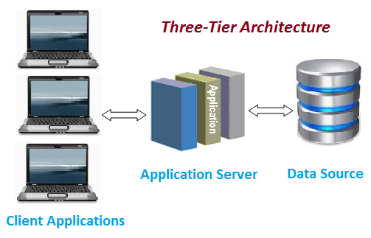
TECHNICAL BRANCH
PHYSICAL ARCHITECTURE

Slide 19
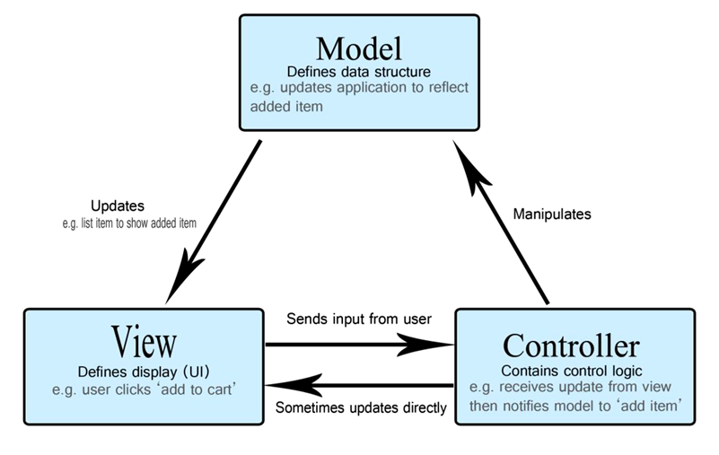
TECHNICAL BRANCH
LOGICAL ARCHITECTURE

Slide 20

STEP- BY-STEP DEMONSTRATION OF HOW THIS PLATFORM FUNCTIONS

Slide 21

CONCLUSION
PERSPECTIVES

Slide 22

THANK YOU

